Slide 1


Slide 2
MATchmaker Mapping buprenorphine access & need
8
Dave Slinger
David Bowden
Yuxin Chen
Josephine Dru
Holly Giang
Becca Nock
Luke Shi
Sam Tan
Notes:
Welcome to “MATchmaker”! We are Team 8, and we began this project with an interest in mapping. {*}}

Slide 3
Research Question
How does access to licensed buprenorphine providers compare with the areas of highest need for medication-assisted treatment (MAT) in Philadelphia?
access need
Notes:
Our research question compares {*} access with need. {*}}

Slide 4
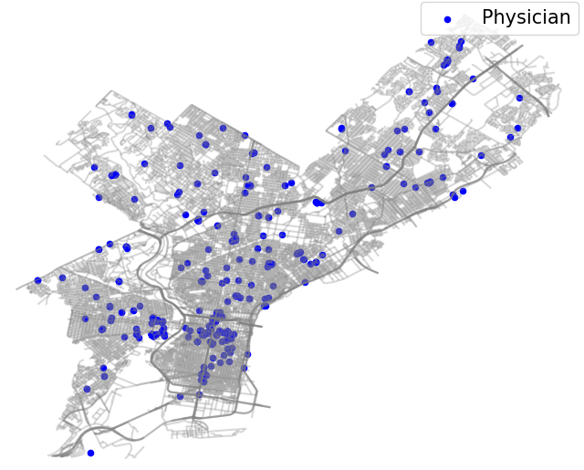
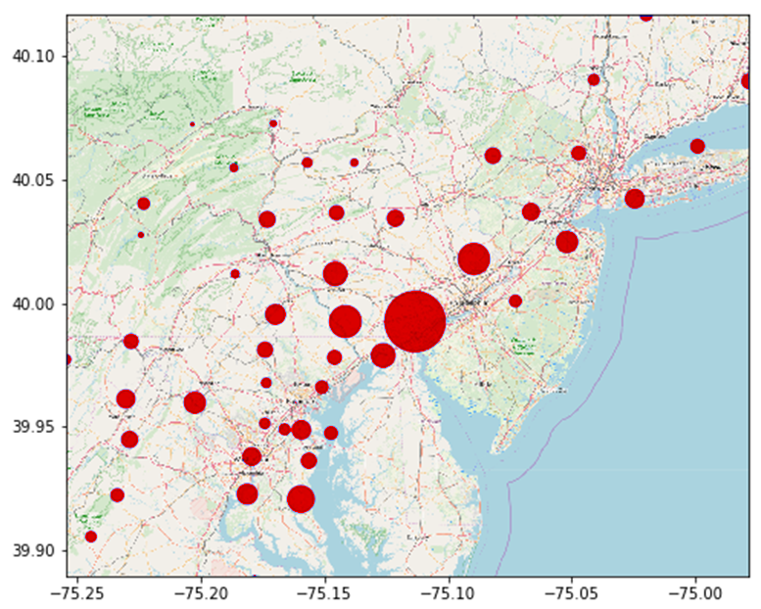
What interested us?
EMS naloxone administrations by zip code (2014–2019H1)
Buprenorphine providers in Philadelphia (SAMHSA, Dec 2019)
need
(overdoses)
access
(MAT)
Mapping comparisons for Narcan and buprenorphine
Notes:
On the first night of this hackathon we learned about Narcan from Prevention Point {*} and buprenorphine from Health Federation {*}. Initially we wanted to bring these datasets together with a geographic focus. {*} We learned a lot about challenges for both topics. (Tonight’s presentation will focus mostly on buprenorphine access, {*} but we have some additional maps on assessing need that might fit with the Narcan team’s focus.) {*}}

Slide 5
Presentation Goal
to help you …
.help us help you better!...
Notes:
The goal of this presentation is to identify the problems we tried to help you solve {*}, and show how we did and didn’t succeed, so you can {*} help us help you better! We thought mapping buprenorphine locations could help two groups of people: {*}}

Slide 6
Who needs MATchmaking?
Anyone involved in warm handoffs or referrals:
Anyone who can help improve services:
to find a suitable buprenorphine prescriber (location, hours, affordability, other services, etc.)
to match buprenorphine availability to needs
to update information about MAT!...
Notes:
anyone involved in warm handoffs or referrals {*} and {*} anyone who can help improve services. Ideally we want to make two maps. The first map would help people {*} find a suitable buprenorphine provider. (This map would serve first responders, opioid users, friends, family, and case workers.) The second map would {*} show where more buprenorphine is needed. (This map would serve organizations like Health Federation, treatment providers, and policymakers.) … What we discovered is that both of these goals need a prior step: {*} updating information about MAT for accuracy and completeness. One topic we’d like to discuss in Q&A is how to work together on these data challenges: {*}}

Slide 7
DATA CHALLENGES | CURRENT SOLUTIONS | FUTURE SOLUTIONS
Scattered sources with different information | Collecting & centralizing in one master reference: Google Maps (5 layers, easy to compare) | Add other key sources. Share updates with DBHIDS / other info distributors?
Useful information in hard-to use formats | Turned Word document, PDF maps, and PDF list/chart into spreadsheets | Provide training and templates for data collection & formatting? Do further manual conversions?
Inaccurate information (especially provider addresses) | Identifying information conflicts/problems to fix (typos, residential, outdated ...) | Figure out easy ways for providers (& volunteers?) to update addresses regularly
Unavailable information (esp. # of waivers not in use; data privacy makes measuring need tricky) | For waivers: [nothing yet] For assessing need: census tract data about insurance, transportation, etc.? | Set up easy ways for providers / programs (& volunteers?) to update waiver data regularly. Analyze census data?
Notes:
This summary slide has a lot of information. Don’t try to read it all now. We’re going to show this slide three times, and you’ll have a copy of the presentation with next week’s report. The main point is that the problems we faced are also problems that our project might help catch and correct. After I take another [20 seconds] to show a few data challenges, {*}}

Slide 8
DATA CHALLENGES | CURRENT SOLUTIONS | FUTURE SOLUTIONS
Scattered sources with different information | Collecting & centralizing in one master reference: Google Maps (5 layers, easy to compare) | Add other key sources. Share updates with DBHIDS / other info distributors?
Useful information in hard-to use formats | Turned Word document, PDF maps, and PDF list/chart into spreadsheets | Provide training and templates for data collection & formatting? Do further manual conversions?
Inaccurate information (especially provider addresses) | Identifying information conflicts/problems to fix (typos, residential, outdated ...) | Figure out easy ways for providers (& volunteers?) to update addresses regularly
Unavailable information (esp. # of waivers not in use; data privacy makes measuring need tricky) | For waivers: [nothing yet] For assessing need: census tract data about insurance, transportation, etc.? | Set up easy ways for providers / programs (& volunteers?) to update waiver data regularly. Analyze census data?
Notes:
Dave and David will demonstrate our current solutions, and then {*}}

Slide 9
DATA CHALLENGES | CURRENT SOLUTIONS | FUTURE SOLUTIONS
Scattered sources with different information | Collecting & centralizing in one master reference: Google Maps (5 layers, easy to compare) | Add other key sources. Share updates with DBHIDS / other info distributors?
Useful information in hard-to use formats | Turned Word document, PDF maps, and PDF list/chart into spreadsheets | Provide training and templates for data collection & formatting? Do further manual conversions?
Inaccurate information (especially provider addresses) | Identifying information conflicts/problems to fix (typos, residential, outdated ...) | Figure out easy ways for providers (& volunteers?) to update addresses regularly.
Unavailable information (esp. # of waivers not in use; data privacy makes measuring need tricky) | For waivers: [nothing yet] For assessing need: census tract data about insurance, transportation, etc.? | Set up easy ways for providers / programs (& volunteers?) to update waiver data regularly. Analyze census data?
Notes:
Becca and Sam will explain possible future solutions. {*}}

Slide 10
Data
need:
City of Philadelphia’s reports & dashboards
Census data
access:
Buprenorphine listings*
Health Federation intern’s research notes on local FQHCs
Notes:
Here’s a list of our main data sources for the topics of need and access.
-----
(Philly = data re: need | other sources = data re: access)
City of Philadelphia’s online reports, dashboards, etc. (if time permits, show quick view of “dashboards” link for glance at all the visualizations already available). [Existing map of naloxone admin by zip code has pros & cons: https://public.tableau.com/profile/pdph#!/vizhome/NaloxoneAdministrationsbyFirstResponders/LocationofEMSNaloxoneAdministrations]
From Catherine’s presentation: Health Federation intern’s research notes about MAT at local FQHCs (federally qualified health centers) = January 2020

Slide 11
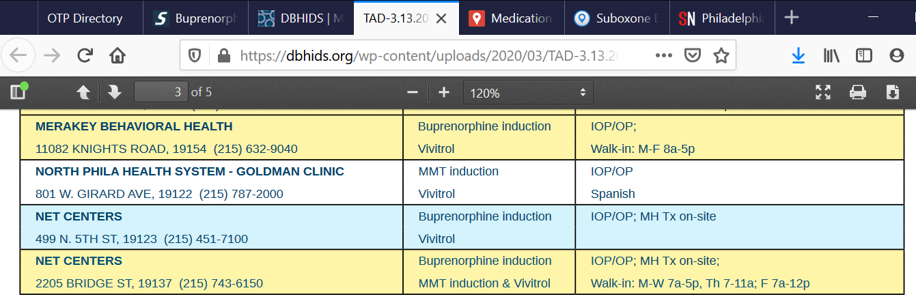
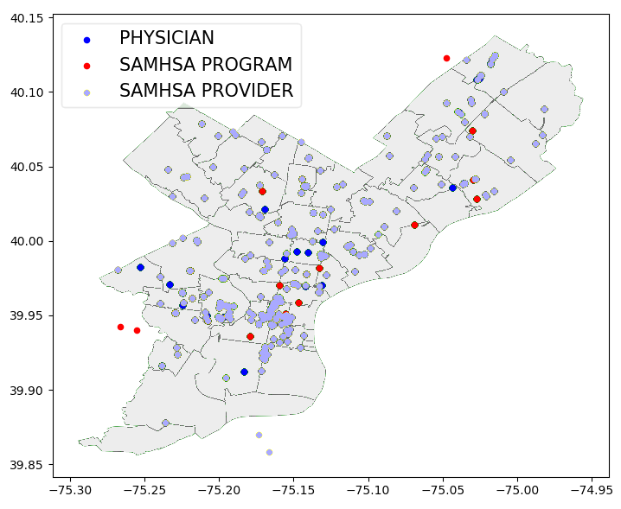
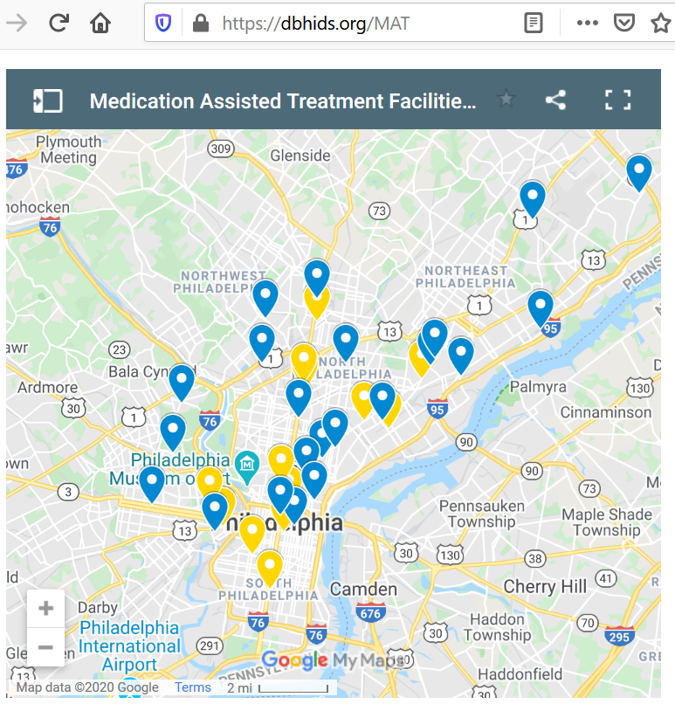
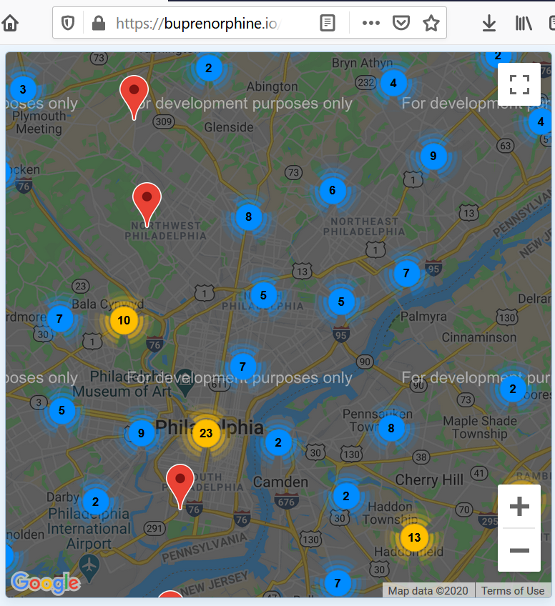
Data Challenge:
SAMHSA: buprenorphine providers & opioid treatment programs (OTPs)
Philadelphia DBHIDS: “Treatment Availability Database” (TAD) … and MAT map
Buprenorphine.io: “Suboxone Doctors in Philadelphia, Pennsylvania”
Scattered sources with incomplete information
Notes:
We found different information about buprenorphine providers in different sources.
-----
SAMHSA datasets prepared by the hackathon organizers
Programs
Providers [https://www.samhsa.gov/medication-assisted-treatment/practitioner-program-data/treatment-practitioner-locator]
Waiver #s from Marieke’s research = December 2019
Checking addresses with NPI registry [https://npiregistry.cms.hhs.gov/]: want practice, not residential
Also Sobernation, “Find a Rehab in Philadelphia, PA”…
includes several programs that offer buprenorphine for OUD but are not listed in the other sources:
https://sobernation.com/listing/rehab-after-work-philadelphia-pa/
Address: 1420 Walnut Street Suite 500, Philadelphia, PA, 19102
https://sobernation.com/listing/philadelphia-va-medical-center-pvamc-opioid-treatment-program-philadelphia-pa/
Address: 3900 Woodland Avenue , Philadelphia, PA, 19104
https://sobernation.com/listing/philadelphia-va-medical-center-pvamc-addiction-recovery-unit-philadelphia-pa/
Address: 39th and Woodland Avenue , Philadelphia, PA, 19104

Slide 12
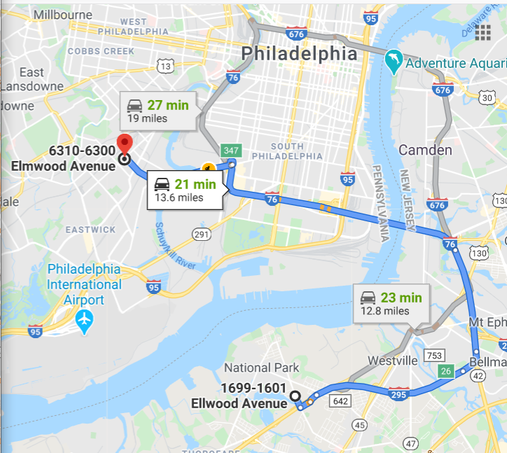
Data Challenge:
Where … ?
How many … ?
Problems with addresses
Uncertainty about waiver numbers
How to handle inaccurate and missing data?
Notes:
[animate text after turning bullet points into script narrative (image illustrates effect of one typo — Ellwood vs. Elwood — on geocodes)]
Two major questions for comparing access and need:
A. Where are buprenorphine programs & providers relative to OUD overdose locations?
B. How many buprenorphine waivers are available, compared to number of candidates for MAT?
Need accurate and complete information to answer both … BUT:
Provider addresses wrong for multiple reasons: typos, residential vs. practice, out of date (moved out of state, moved to another practice site) — make updateable
Number of waivers (codebooks): “Because the [SAMHSA search] form uses only the last name of the physician and pulls from a national database, it oftentimes returned a different practitioner ...”
Different pieces in different sources — wants centralizing (bring together key datasets)

Slide 13
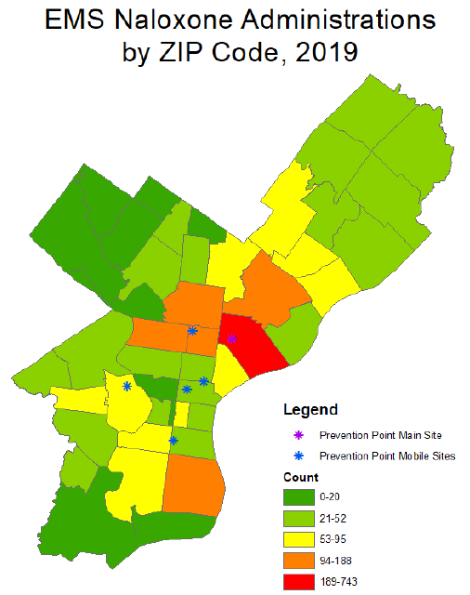
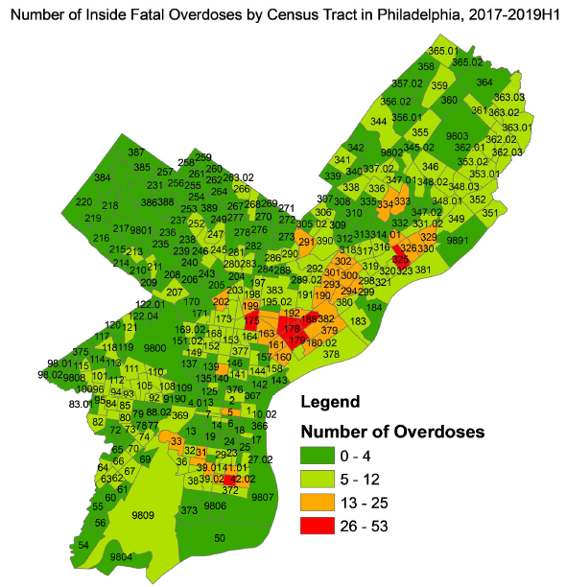
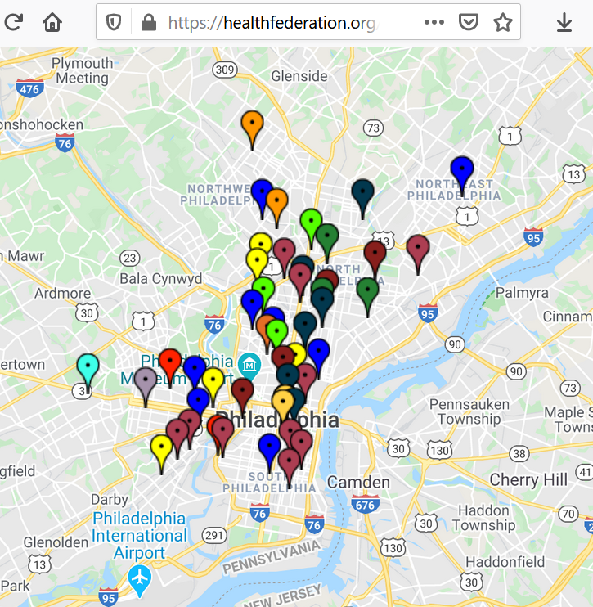
Data Challenge:
How to centralize and compare diverse datasets?
Notes:
Visual challenge: comparing different maps
Different geographic divisions: zip code (left) vs. census tract (center)

Slide 14
DATA CHALLENGES | CURRENT SOLUTIONS | FUTURE SOLUTIONS
Scattered sources with different information | Collecting & centralizing in one master reference: Google Maps (5 layers, easy to compare) | Add other key sources. Share updates with DBHIDS / other info distributors?
Useful information in hard-to use formats | Turned Word document, PDF maps, and PDF list/chart into spreadsheets | Provide training and templates for data collection & formatting? Do further manual conversions?
Inaccurate information (especially provider addresses) | Identifying information conflicts/problems to fix (typos, residential, outdated practice matches) | Figure out easy ways for providers (& volunteers?) to update addresses regularly
Unavailable information (esp. # of waivers not in use; data privacy makes measuring need tricky) | For waivers: [nothing yet] For assessing need: census tract data about insurance, transportation, etc.? | Set up easy ways for providers / programs (& volunteers?) to update waiver data regularly. Analyze census data?
Notes:
copy #2: Current Solutions (Dave + David Google Maps demo)

Slide 15
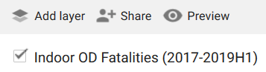
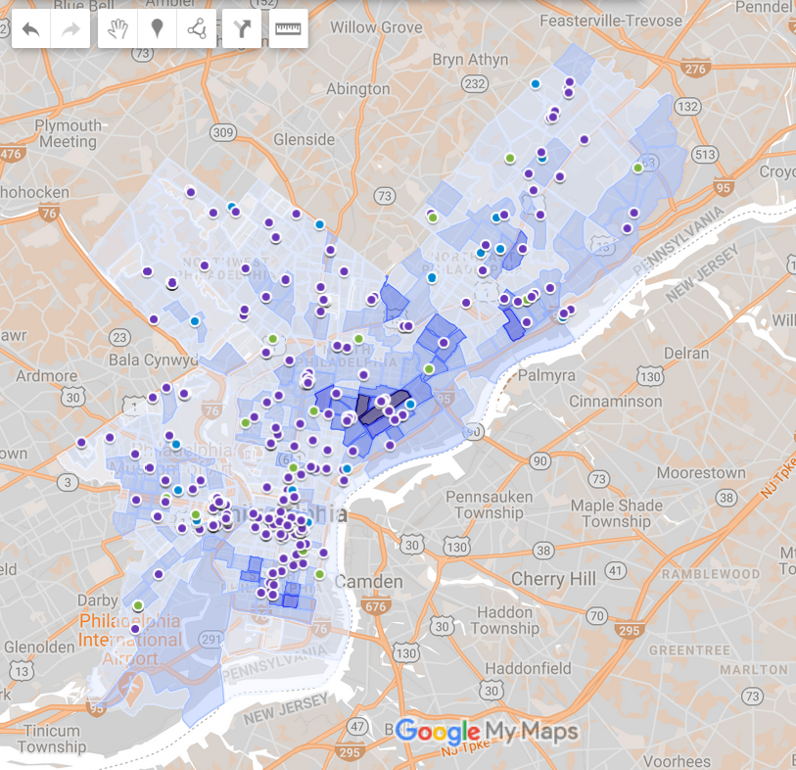
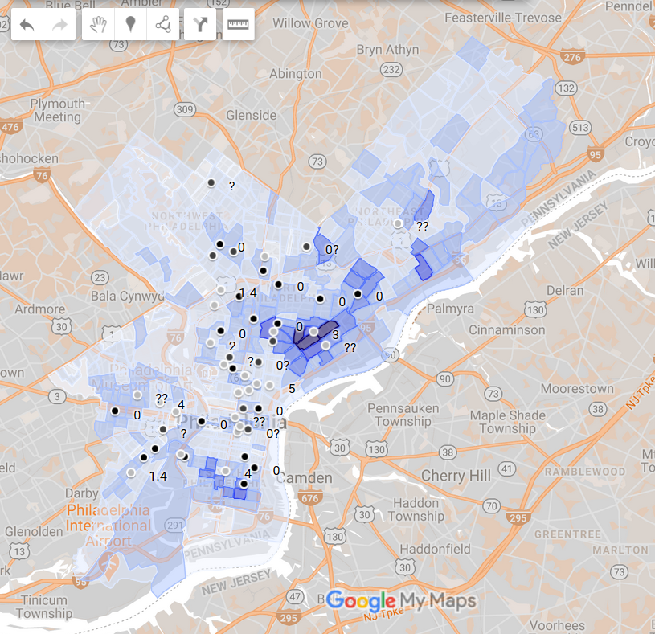
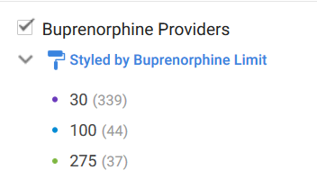
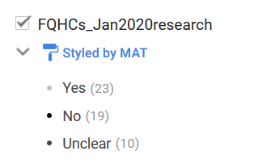
Current Solution:
Layer key data in one Google Maps
Notes:
-----
Brief intro — promise demo ahead (but highlight Challenge #2 first) … Also: Will there be an R Shiny demo in this presentation? Important: Help partners understand what each option can & can’t do (Google Maps | R Shiny)

Slide 16
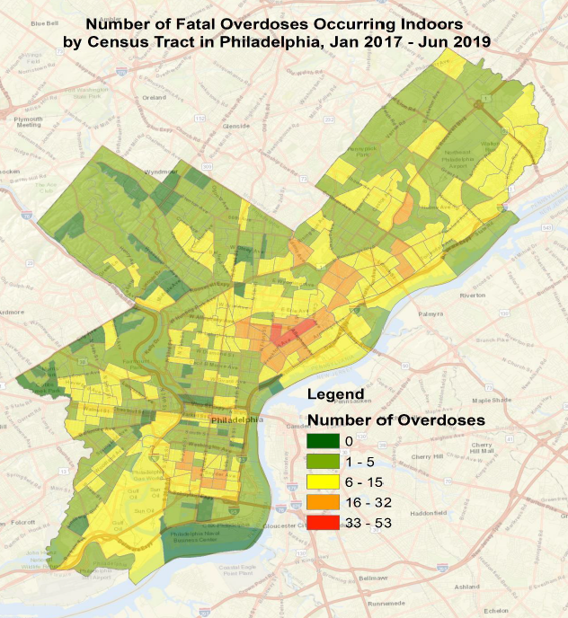
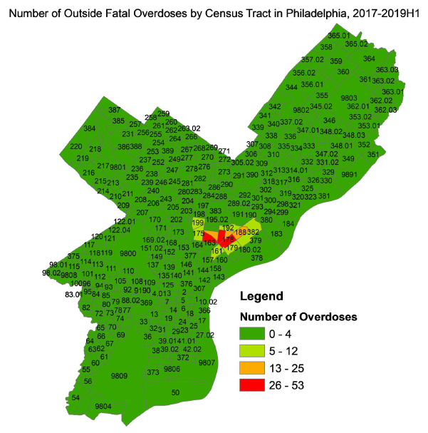
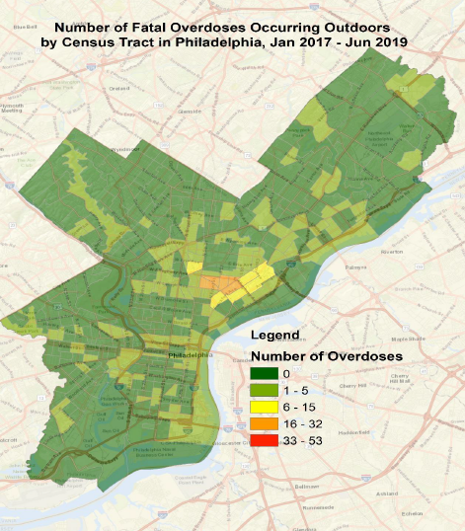
Visualizing need by census tract
Notes:
Detailed information at the census-tract level was found in the city’s Opioid Misuse and Overdose Report
(census tract more detailed than zip codes for locations)
[Slide shows outdoors fatalities first. Click to reveal indoors maps.]

Slide 17
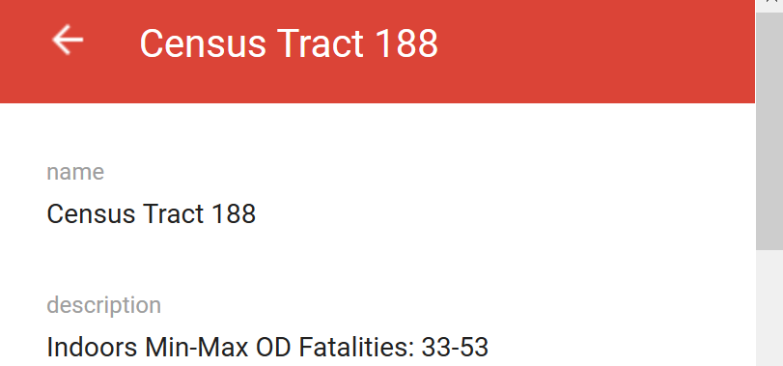
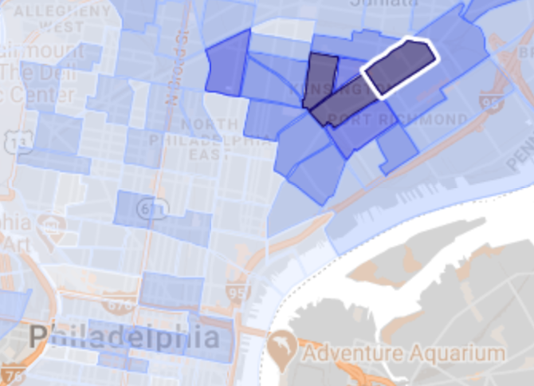
Visualizing need by census tract
Opioid report data was transformed into a KML file to import into Google Maps
Shaded by number of indoor OD fatalities
Clicking tract also gives info on outdoor and total OD fatalities
Notes:
DAVE: Explain why & how this layer was created
[Notice major benefit: showing overdoses on same map makes it much easier to compare locations with buprenorphine … plus (future solutions) census data]

Slide 18
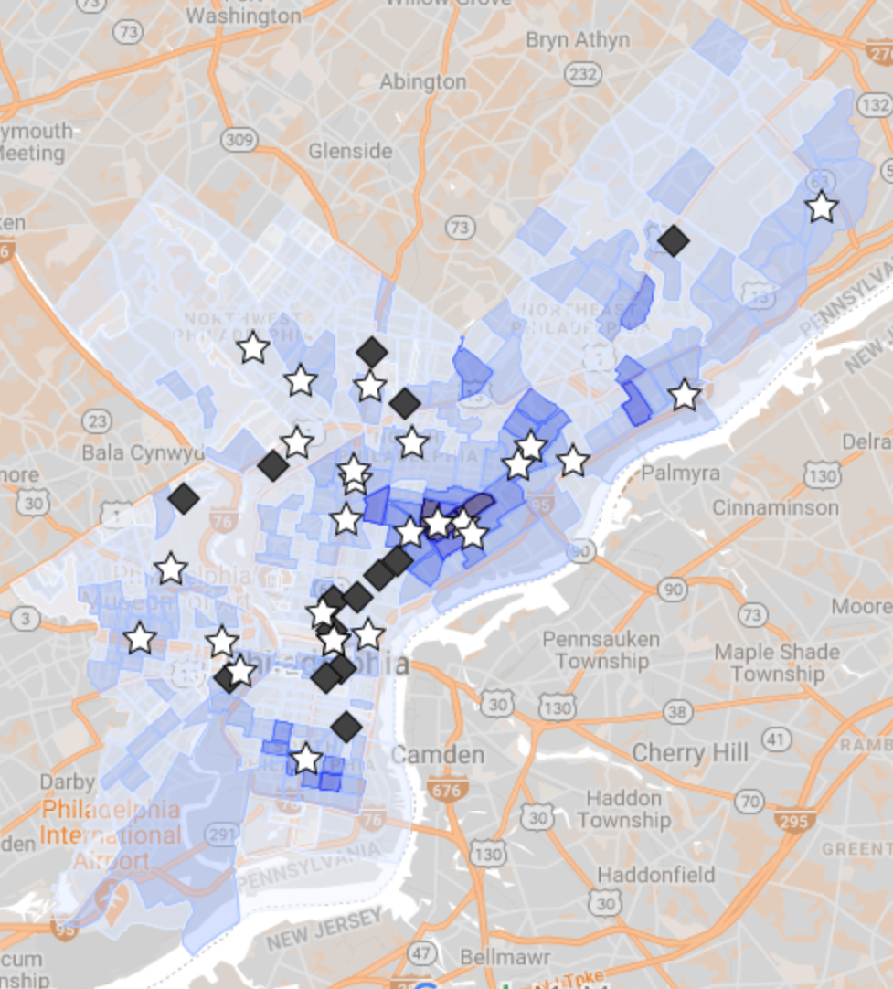
Philadelphia “Treatment Availability Database”
The Philadelphia DBHIDS (Department of Behavioral Health and Intellectual disAbility Services) provides a “Treatment Availability Database” (TAD) as a printable PDF.
We translated their Winter 2020 listings for MAT into this map layer:
Stars = Buprenorphine
Diamonds = Other MAT
Notes:
DAVE: Explain ...

Slide 19
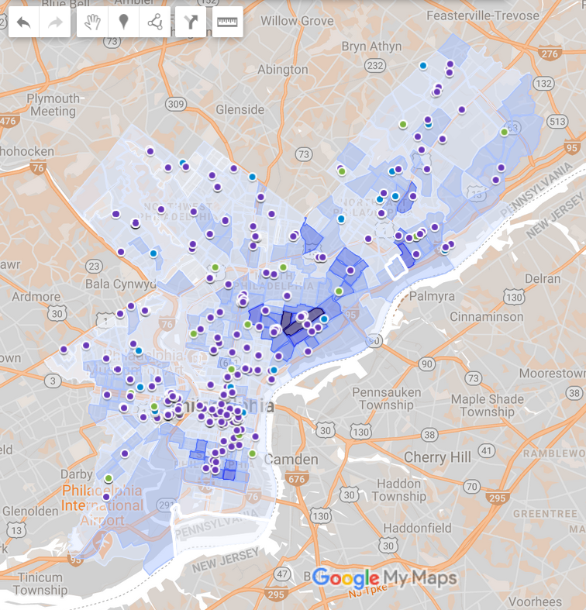
Demo: Visualizing access
Toggle layers to choose datasets
Zoom out to see entire city
Zoom in to compare specifics
Click on individual markers to check details
Notes:
DAVID: Live (on-screen) demo

Slide 20
DATA CHALLENGES | CURRENT SOLUTIONS | FUTURE SOLUTIONS
Scattered sources with different information | Collecting & centralizing in one master reference: Google Maps (5 layers, easy to compare) | Add other key sources. Share updates with DBHIDS / other info distributors?
Useful information in hard-to use formats | Turned Word document, PDF maps, and PDF list/chart into spreadsheets | Provide training and templates for data collection & formatting? Do further manual conversions?
Inaccurate information (especially provider addresses) | Identifying information conflicts/problems to fix (typos, residential, outdated ...) | Figure out easy ways for providers (& volunteers?) to update addresses regularly.
Unavailable information (esp. # of waivers not in use; data privacy makes measuring need tricky) | For waivers: [nothing yet] For assessing need: census tract data about insurance, transportation, etc.? | Set up easy ways for providers / programs (& volunteers?) to update waiver data regularly. Analyze census data?
Notes:
copy #3: Future Solutions (Becca on how to use & where to go)

Slide 21
How can we use this?
Health Federation
Educate service providers on how to use the tool - how do referrers find the right office?
Target new practices or providers and encourage them to get waivers
Continue to expand the tool as Code for Philly project
Notes:
Current Google Maps = HFP can use for the two goals listed (show referrers how to find buprenorphine providers in Philly now) — at least shows practices you might not have known about that are located conveniently

Slide 22
Future Projects
Immediate priorities
Add a way for physicians and practices to update their information within the tool (how many waivers they have, new locations, etc.)
Add information about the offices/practices (hours, weekend availability, childcare, etc.)

Slide 23
Future Projects
Stretch goals
Explore additional mapping tools: R Shiny? Other?
More complex search options
Figure out how to make info updates easy
Pharmacies? (this 2019 article identified bottleneck)
Census data for assessing need?
Notes:
[[Assessing need: Our team has also been curious about:
Census data: Attributes of underserved areas?
Change over time? By season? (Example: for mobile centers)]]

Slide 24
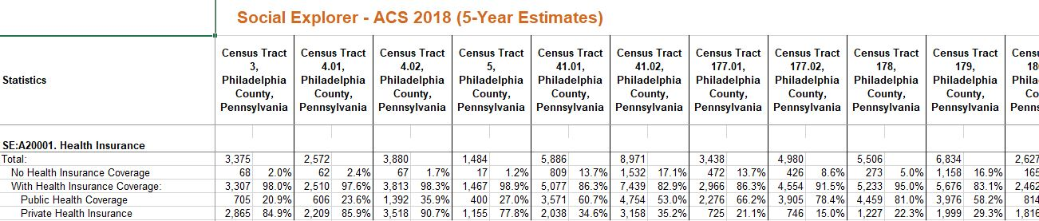
Assessing Need? – Health Insurance
Notes:
Sam’s work with Social Explorer (can be continued)
Compare high OD fatalities in tracts 41, 42; 178, 188, and 177.02 ...

Slide 25
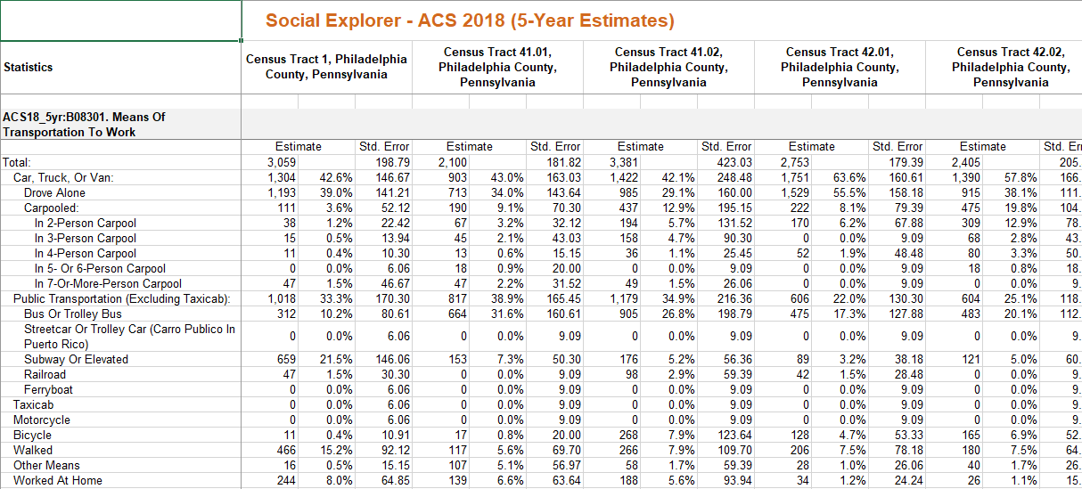
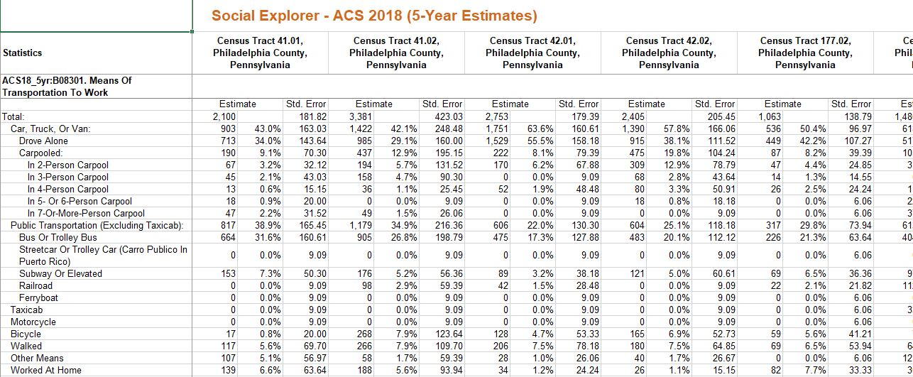
Assessing Need? – Means of Transportation
Notes:
Sam’s work with Social Explorer (can be continued)
Compare high OD fatalities in tracts 41, 42; 178, 188, and 177.02 ...

Slide 26
Questions?
8
Dave Slinger
David Bowden
Yuxin Chen
Josephine Dru
Holly Giang
Becca Nock
Luke Shi
Sam Tan

Slide 27
DATA CHALLENGES | CURRENT SOLUTIONS | FUTURE SOLUTIONS
Scattered sources with different information | Collecting & centralizing in one master reference: Google Maps (5 layers, easy to compare) | Add other key sources. Share updates with DBHIDS / other info distributors?
Useful information in hard-to use formats | Turned Word document, PDF maps, and PDF list/chart into spreadsheets | Provide training and templates for data collection & formatting? Do further manual conversions?
Inaccurate information (especially provider addresses) | Identifying information conflicts/problems to fix (typos, residential, outdated ...) | Figure out easy ways for providers (& volunteers?) to update addresses regularly.
Unavailable information (esp. # of waivers not in use; data privacy makes measuring need tricky) | For waivers: [nothing yet] For assessing need: census tract data about insurance, transportation, etc.? | Set up easy ways for providers / programs (& volunteers?) to update waiver data regularly. Analyze census data?
Notes:
Reference slide for Q&A

